Slide 1
Retail Sales Dashboard
Presented by Komal Chaurasiya

Slide 2
Objective
To analyze and visualize sales performance
Help stakeholders make data-driven decisions
Identify growth opportunities and challenges

Slide 3
Sample Data - Retail Sales Dataset
Source: Sample - retailsalesdataset.csv
Making KPI Chart By Sales, Profit And Growth: Removed nulls, reformatted date fields
Tools used: Tableau for dashboard creation
Add Cards For Total Sale, Product Sold Of And Average Price Of The Year.

Slide 4
Key KPIs Tracked
Total Sales : 2024 (530rs.)
Profit : Loss (99.70%)
Quantity Sold : 2514

Slide 5
Insights
Highest profit observed in West region
Sales peak during November and December
Top 10 customers contribute ~40% of total revenue
Furniture category underperforming despite high margins

Slide 6
Recommendations
Focus on profitable regions like West and East
Boost promotions for Furniture category
Increase marketing during Q4 (holiday season)
Nurture top-performing customer accounts

Slide 7
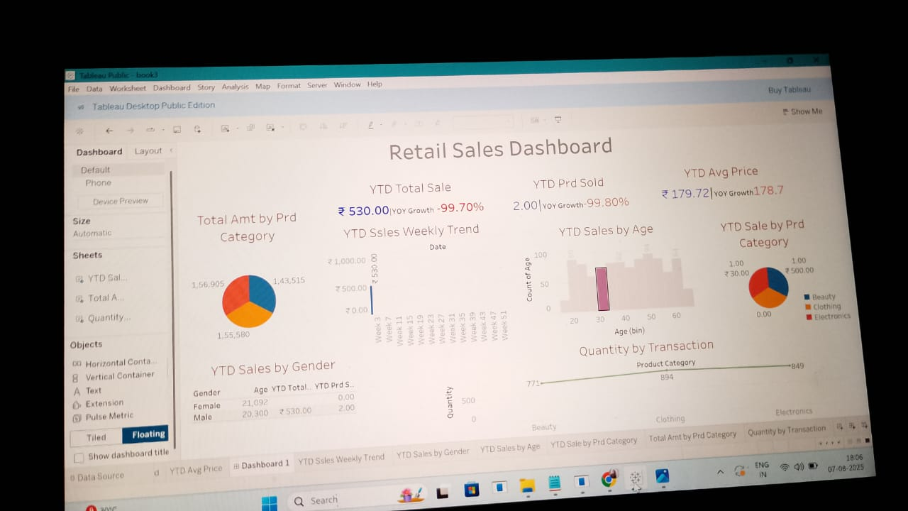
Dashboard Demo
Below is a screenshot of the Tableau dashboard with filters and visuals

Slide 8
Conclusion
Sales concentrated in specific regions and timeframes
Opportunities exist in underperforming categories
Effective strategies can boost overall profitability

